Slide 1
Bridge Design Project
Using SolidWorks and SolidWorks SimulationXpress to design, test and
build structures

Slide 2
1 - Introduction

Slide 3
Prerequisites
Prerequisites for this project.
SolidWorks files come in three basic types; parts, assemblies and drawing.

Slide 4
2 - Structure Design

Slide 5
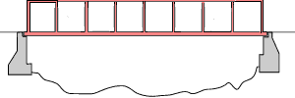
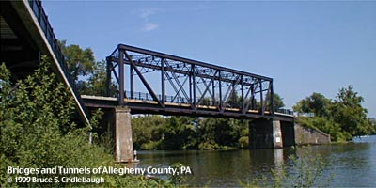
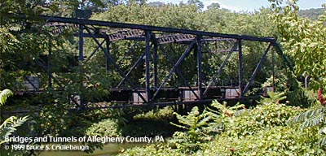
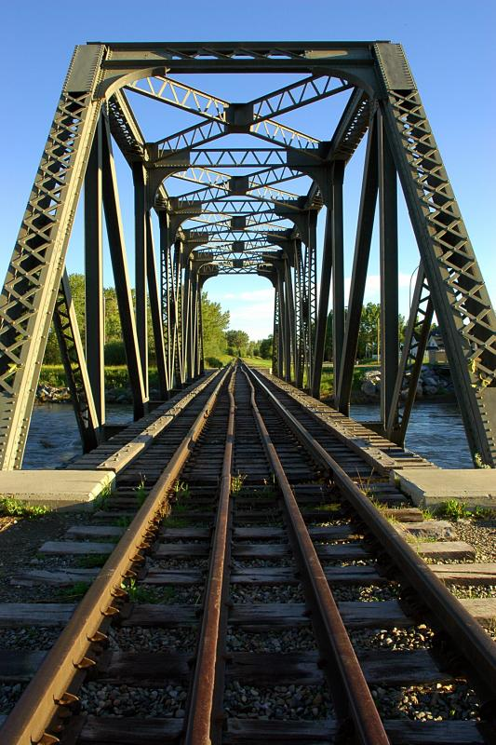
What are Trusses?
Trusses are simple structures used as bridges for railroads, auto and foot traffic; capable of carrying large loads across spans. They consist of a road or rail surface, 2 walls and sometimes bracing between the walls.

Slide 6
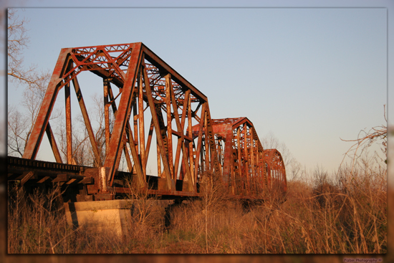
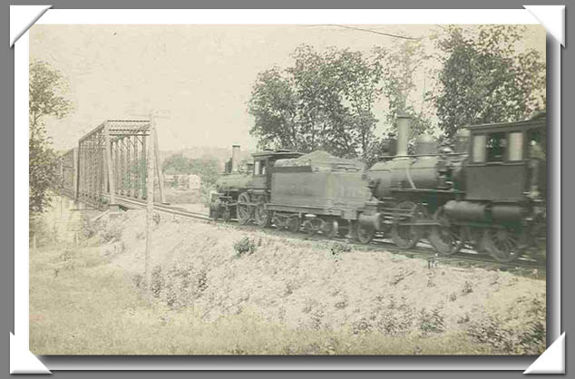
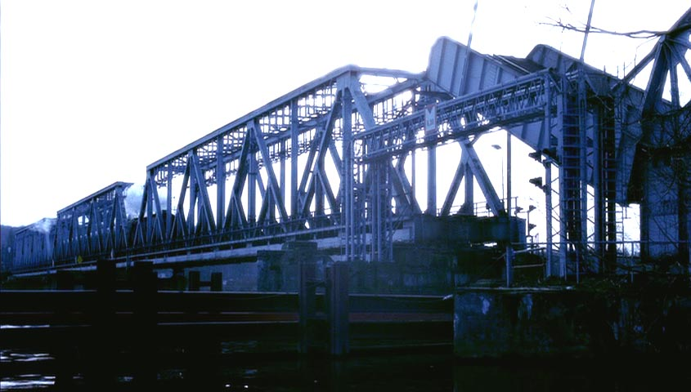
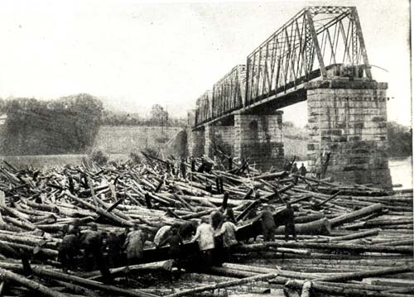
Longer Spans
For longer spans, the truss structure can be repeated several times.

Slide 7
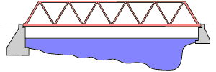
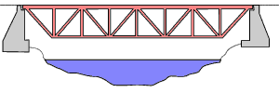
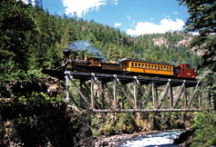
Truss Types
The Warren truss, shown at right, is one of the simplest and most economical types. It can even be used upside down, in this case with added vertical members.

Slide 8
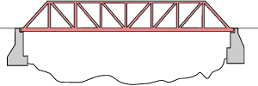
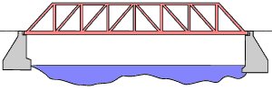
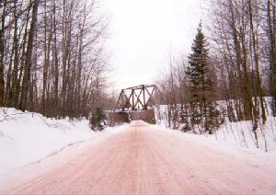
Truss Types (con’t)
The Pratt (above) and Howe (below) are other common types. We will look at a truss similar to the Pratt truss.

Slide 9
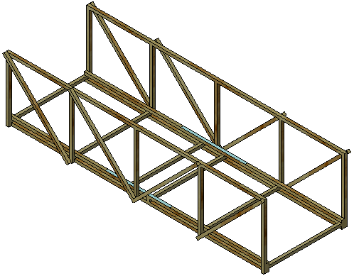
Truss Walls
The side walls of the truss are much more than walls that keep the trains or cars from falling off the truss. They are used to absorb and direct the loads placed on the truss such as trains cars.

Slide 10
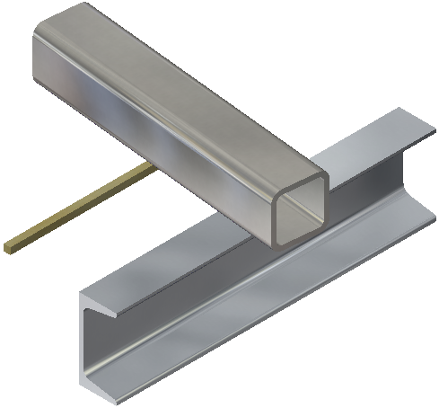
Beams
Trusses are made up of beams that are held together by bolts, welds or rivets. A common example of a beam is a closet rod used to hang clothes.
Beams have the same cross section.

Slide 11
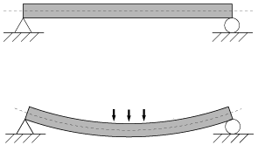
Loads
Loads are forces that are applied to the beam. A common load on a beam would be weight, such as a train car. Loads are usually applied over an area of the beam.

Slide 12
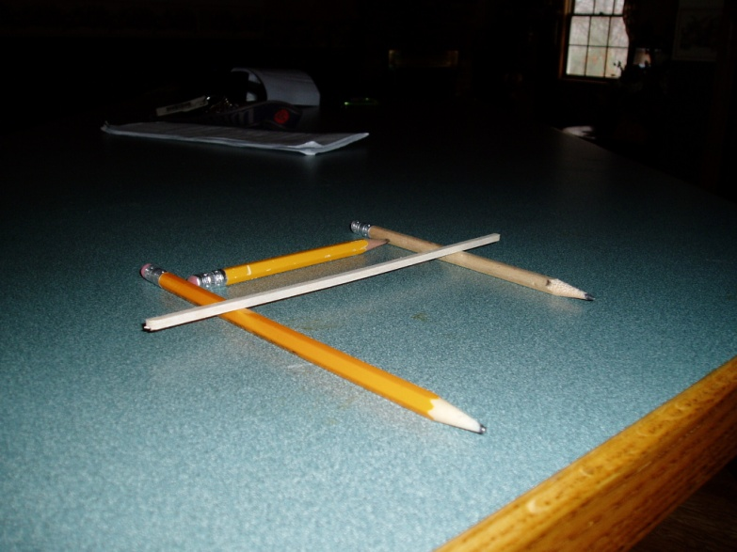
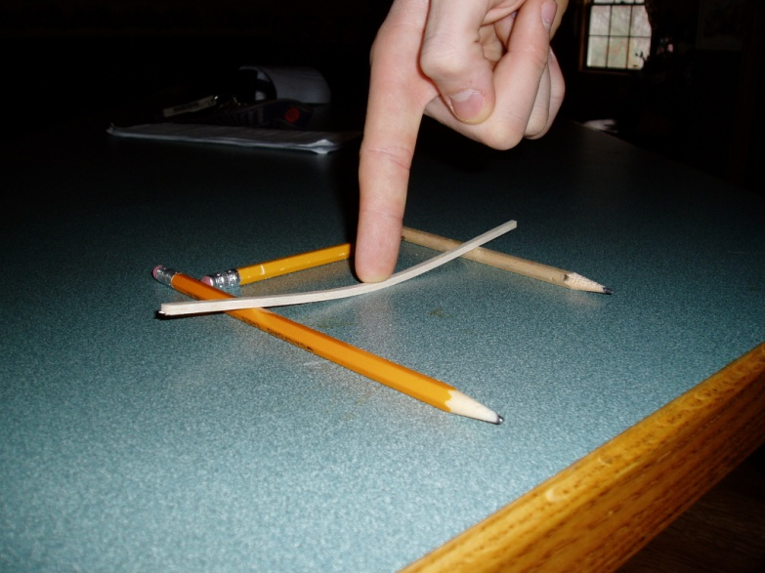
Bending and Deflection
Bending is caused by a load that is applied to a beam. The load causes the beam to bend and move in the direction of the load. The deflection is how far the beam moves from it’s original position. The larger the load, the larger the deflection. The “worst case” deflection occurs when the load is at the center of the beam.

Slide 13
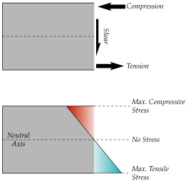
Tension and Compression
While the beam is bending, things are happening within the beam. The top portion of the beam (the face the load is applied) compresses (pushing ends together) while the opposite face sees tension (pulling ends apart).

Slide 14
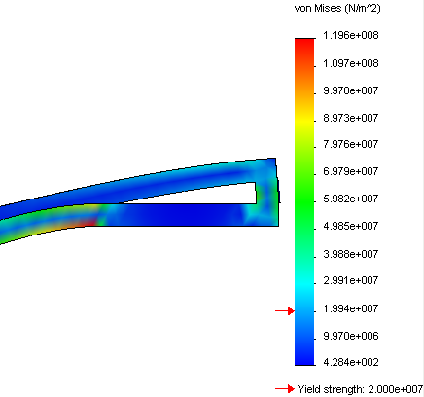
Stress
Stress measures what happens inside the beam when forces are applied. It is defined as force divided by area, common units being newtons per meter squared (N/m^2) or pounds per square inch (psi).
Stress can cause the beam to break under high loads. Analysis provides maps that show areas of high and low stress.

Slide 15
Yield Strength
How much can the beam take before it breaks? We use the Yield Strength as the limit of the beam’s strength based on stress.
Actually it measures the point where a beam bends and remains in the bent shape.
Both the material and beam section contribute to the strength.

Slide 16
Strength of Beams
The cross sectional shape influences the strength.
Using a stronger material (steel rather than wood) makes the beam stronger.
Strength
Cross Section
Shape
Material

Slide 17
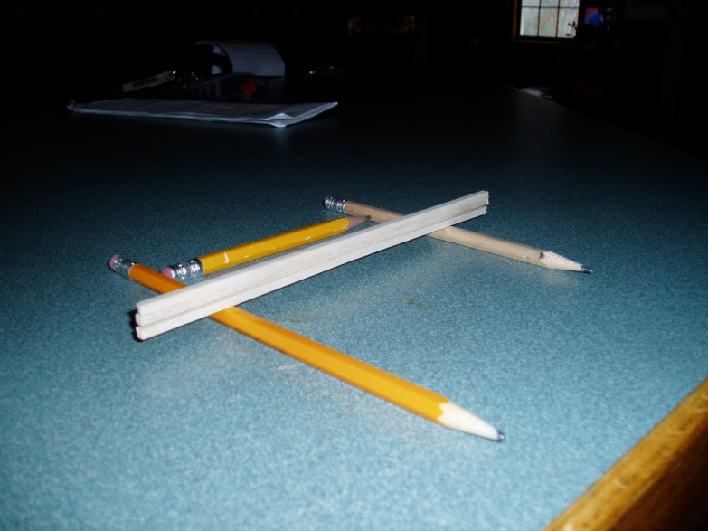
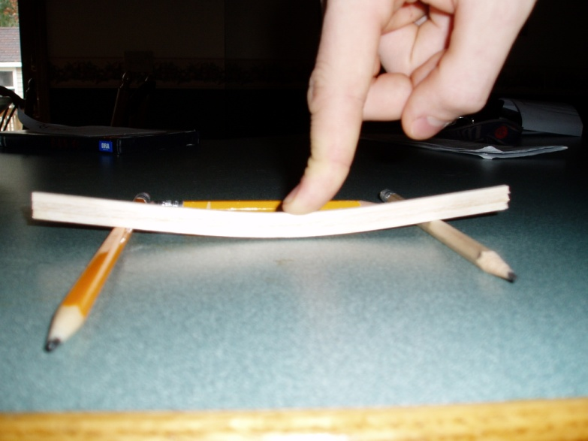
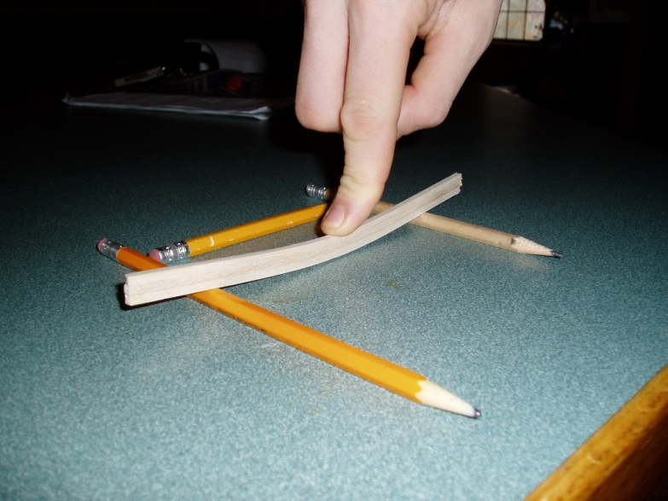
Cross Section Shape
Stacking two or three beams as shown in the image makes the beam harder to bend and stronger against a load.

Slide 18
Section Depth
The deeper the section (left) the stronger the material. Wider sections (right) help a little but not that much.
The reason that deeper beams are stronger is the area moment of inertia. This is calculated using the width (b) and height (h) dimensions of the section.

Slide 19
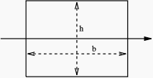

Area Moment of Inertia
For a square section that measures 3.175mm (0.3175cm or 1/8”) on a side, the area moment of inertia is:
1 section = 8.47 base
2 stacked = 67.75 8X stronger
2 side by side = 16.94 2X stronger
3 stacked = 228.64 27X stronger

Slide 20
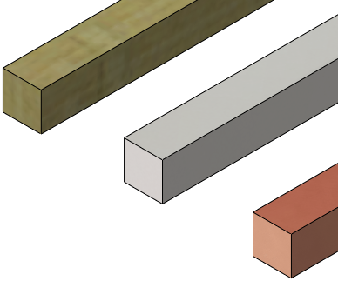
Materials
The material used to create the beam has a great impact on it’s strength. Although there are many varieties of wood and alloys of metals, generally metal is stronger then wood.
Note that wood, unlike metals, has a grain that makes it’s strength different in different directions.

Slide 21



Steel Beams
The deeper beam starts to look like the steel beams used in construction of trusses, and buildings, channels, I-beams and tubes.

Slide 22
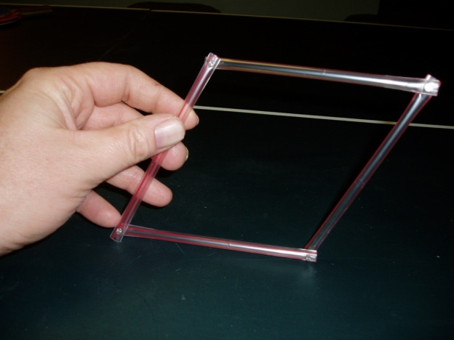
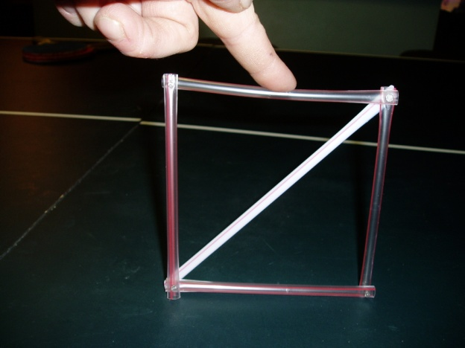
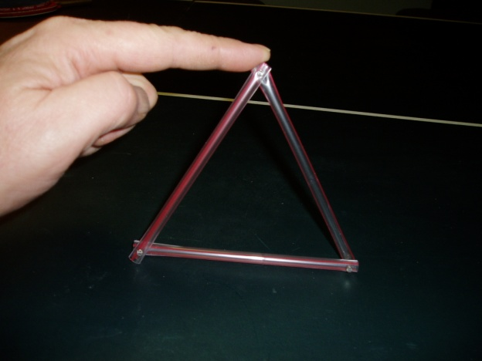
Cross Bracing
Cross bracing stiffens the structure by preventing rotation at the joints.
Using drinking straws pinned at the ends shows the difference that a brace can make.

Slide 23
3 – Analyzing the Structure

Slide 24
Analysis Stages
A Structural Analysis has several stages that are followed in order.
  In SolidWorks:
    Model is where the geometry is created.
  Using SolidWorks SimulationXpress:
    Pre-Processing is used to add materials, restraints and loads.
    Analysis is where the input is “run” through the analyzer.
    Post-Processing allows you to see the results.
Model
Pre-Processing
Analysis
Post-Processing

Slide 25
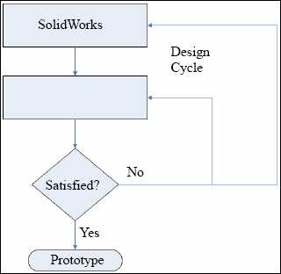
Design Cycle
The Design Cycle is used to “iterate” changes by returning to the original design to change the model. The changes alter the results of the analysis.
SimulationXpress

Slide 26
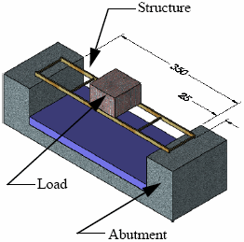
Restraints and Loads
Restraints prevent movement of portions of the structure.
Loads apply forces to the structure.

Slide 27
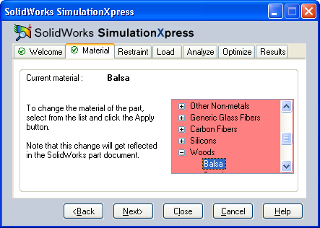
Material
The material selected supplies data to the analysis in the form of numeric properties.

Slide 28
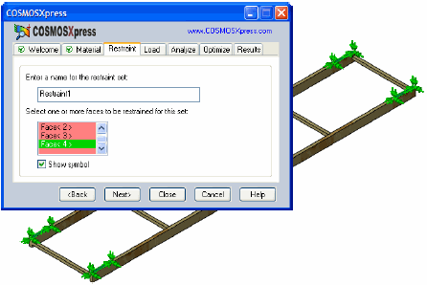
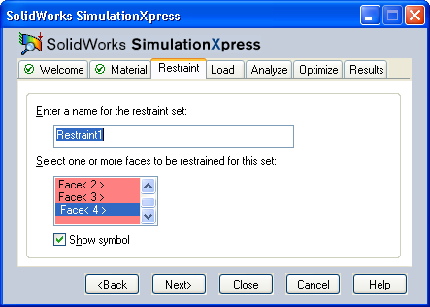
Restraints
The Restraints are applied by selecting faces of the model.

Slide 29
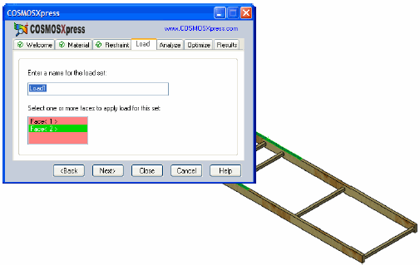
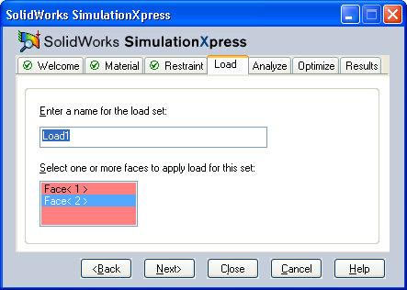
Loads
The Loads are applied by selecting faces of the model.

Slide 30
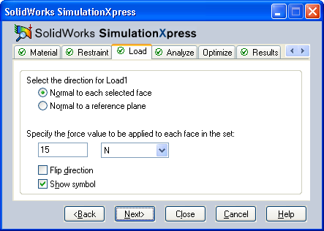
Iterating Changes
If the load is much smaller or much larger than the structure can handle, you can “iterate” a change and re-analyze.

Slide 31
4 - Making Design Changes

Slide 32
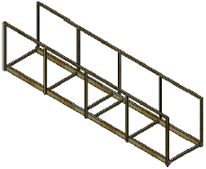
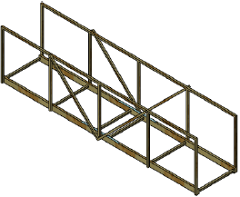
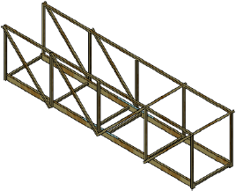
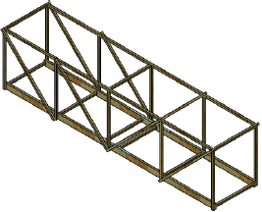
Changes
Using different models, follow the changes in the model and the changes in capacity of the structure.

Slide 33
5 – Using an Assembly

Slide 34
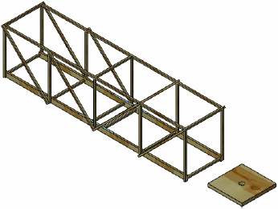
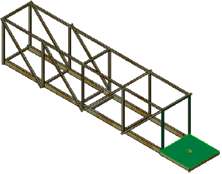
Collision Detection
In an assembly, components can be checked for collision, interference or clash.

Slide 35
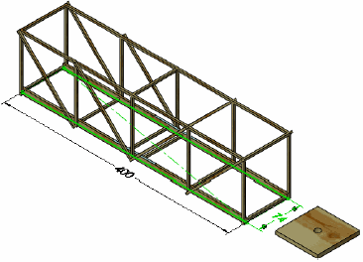
Changing Dimensions
The dimensions that define the shape of the model can also be used to change the size of the model.

Slide 36
6 – Making Drawings of the Structure

Slide 37
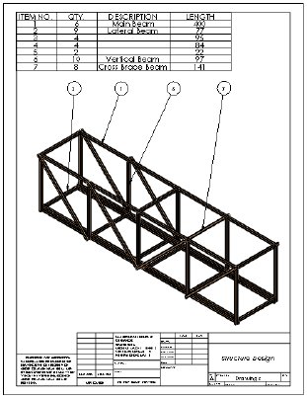
Drawings
The drawing includes a view of the model, a bill of materials and balloons.

Slide 38
7 – Reports and eDrawings

Slide 39
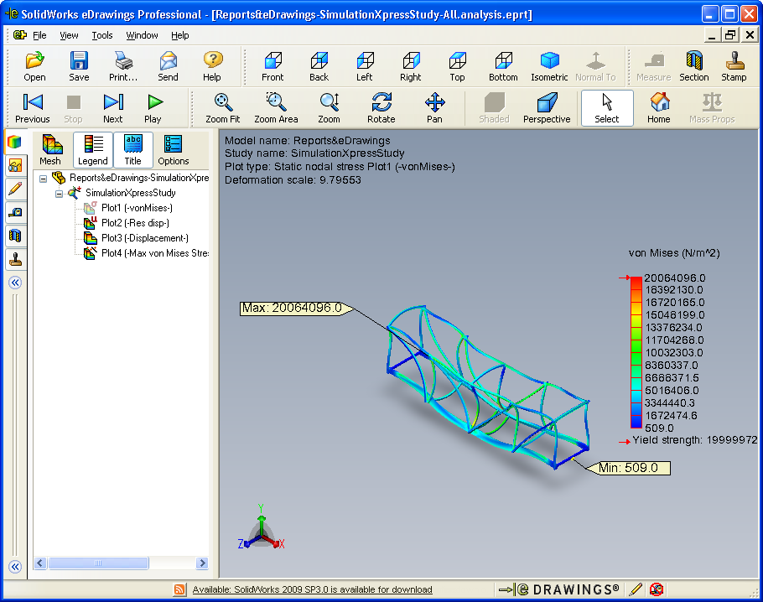
eDrawings
HTML (web format) reports can be generated from the post-processor data.
An eDrawing can be used to send information to other users.

Slide 40
8 – Building and Testing the Structure

Slide 41
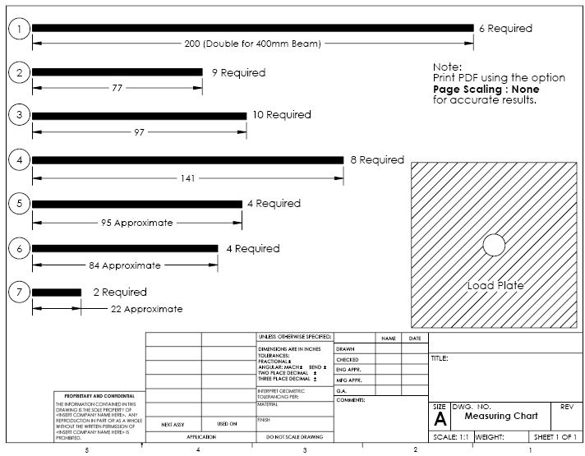
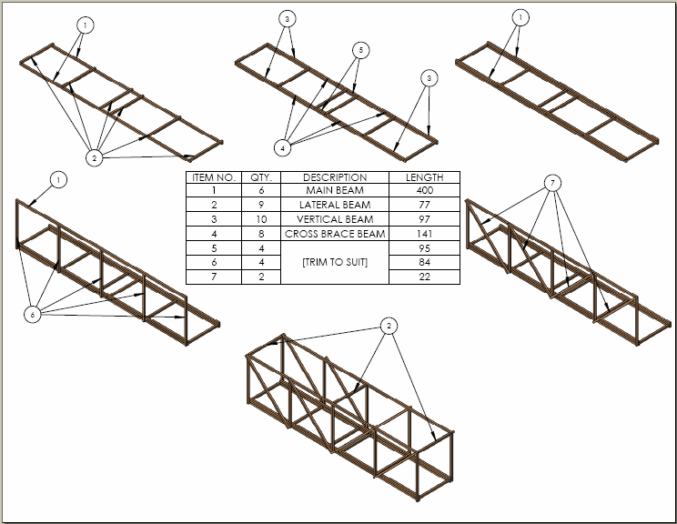
Construction Aids
The PDF files Measuring Chart and Construction Guide can be used to make construction easier.

Slide 42
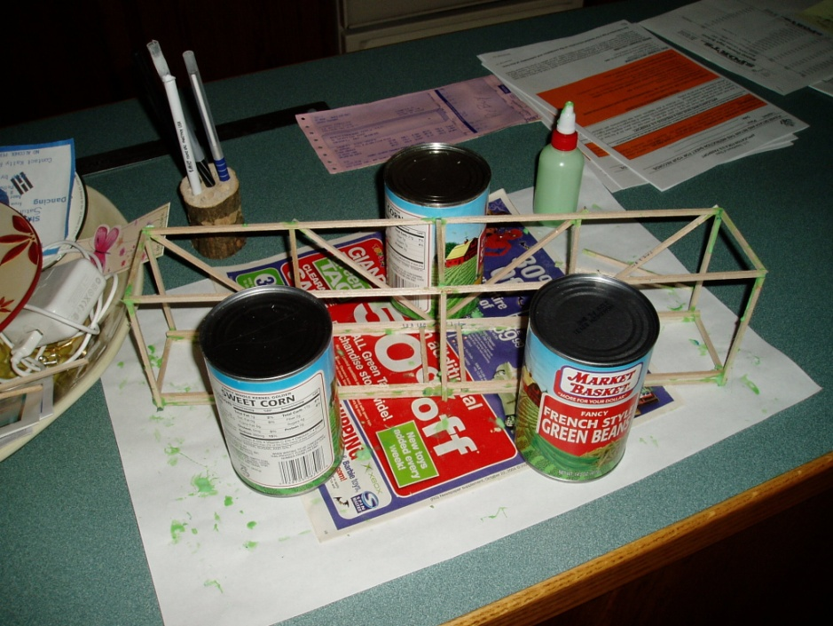
Building the Structure
Distribute 1/8" x 1/8" x 24" balsa sticks, glue and cutters.
Cut, glue and assemble structure per instructions.

Slide 43
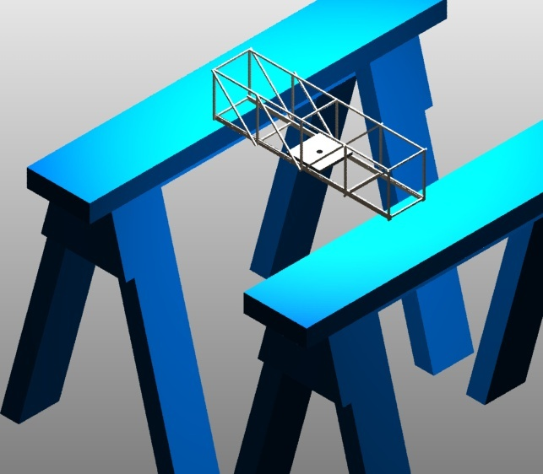


Testing the Structure (setup)
Set up sawhorses or tables to represent the 350mm span.
Place the bridge and load plate across the sawhorses or tables.
Make sure to wear eye protection!

Slide 44


Testing the Structure (test weight)
Use a drawstring bag or bucket with wire attached.
Pass drawstring or wire through hole in load plate and pin in place.
Load bag or bucket with weighted objects until breakage occurs.

